Slide 1
FAKE JOBS PREDICTIONS
Group 8
By:Luong Quang Tuan
Ian Teh Jiazhi
Nguyen Minh Duc
Teh Wei Hao, Bernard

Slide 2
TABLE OF CONTENTS
01
02
03
Conclusion
Exploratory Data Analysis
Pre-processing and Training Process

Slide 3
How the ML problem aims to solve our objective
Employment scams are on the rise.
According to CNBC, the number of employment scams doubled in 2018 as compared to 2017.
Economic stress and the coronavirus impact have significantly reduced job availability and job loss for many individuals -> High unemployment
The scams on job postings allow scammers to gain access to personal information, such as bank account details
Many people are falling prey to these scammers using the desperation that is caused by an unprecedented incident.
Hence, with classification and the use of Natural Language Processing (NLP) , we aim to separate fraudulent and real job postings.

Slide 4
OUR DATASET
Textual information
18,000
fake_job_
postings.csv
800
Meta - information
Total Job Descriptions
Fake Job Descriptions
Type of Machine Learning Project: Classification

Slide 5
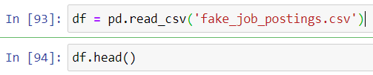
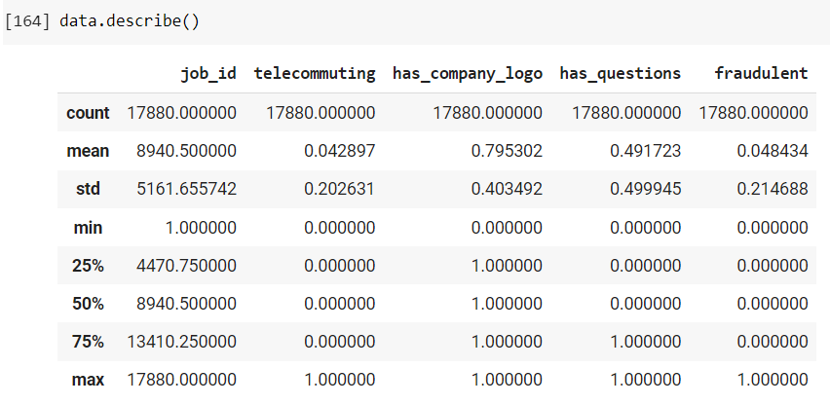
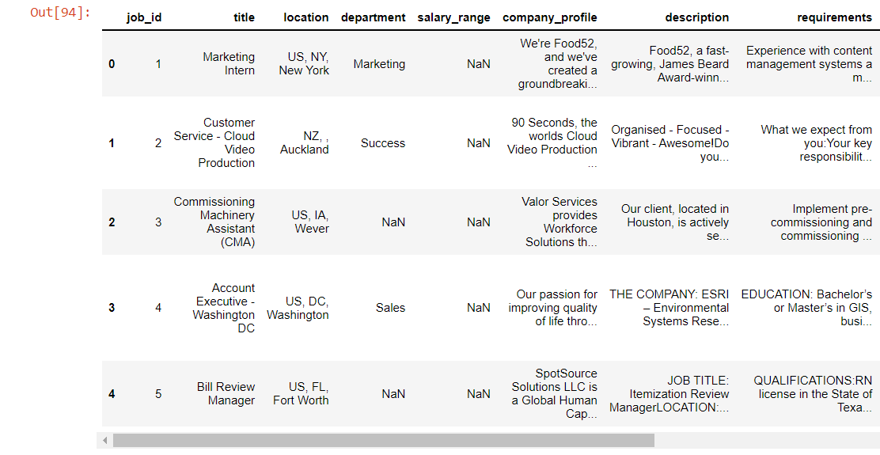
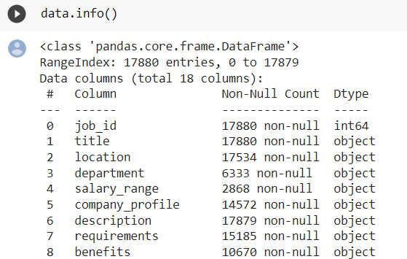
Exploratory Data Analysis - Get Insights about the Dataset
Read and get insights about the datasets using head(), info(), describe() function

Slide 6
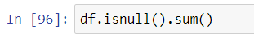
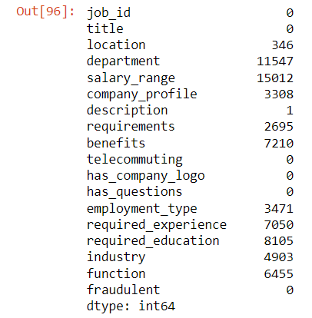
Exploratory Data Analysis - Handling Missing Values
Check if there are any missing values with isnull() function:
As we can see, every column has different amount of missing values. For example, job_id is 0 while location is 346.
To handle missing values, we might drop columns containing NaN / unwanted columns or replace NaN with some values

Slide 7
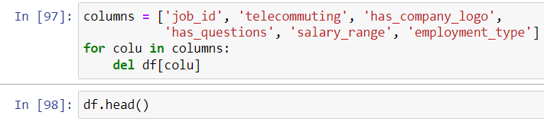
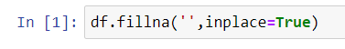
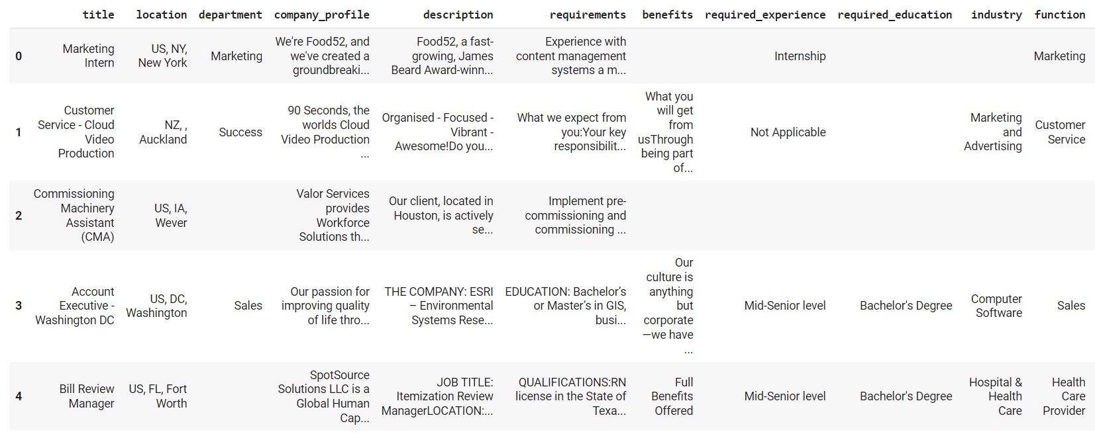
Exploratory Data Analysis - Handling Missing Values
Drop columns containing all missing values or unwanted columns:
Replace missing values in the remaining columns with string “ ”:

Slide 8
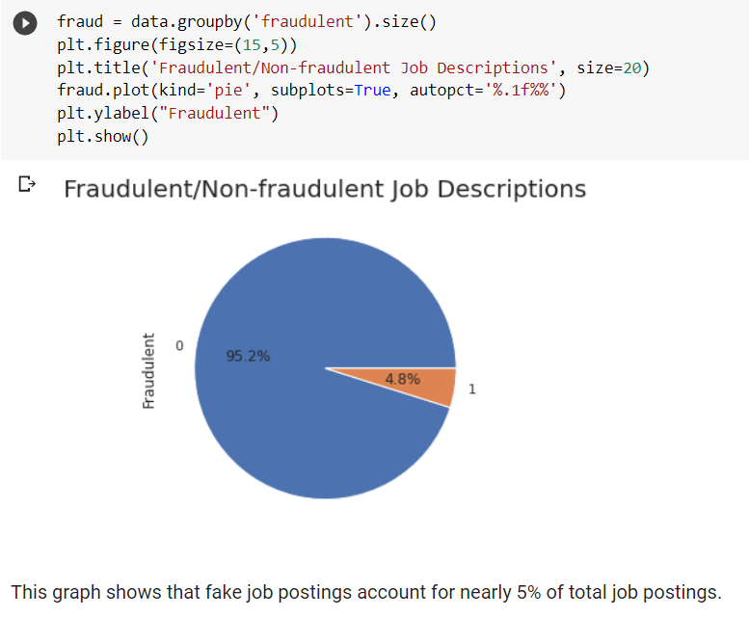
Exploratory Data Analysis - Data Visualization
What percentage does fake job postings account for?
The data is highly unbalanced (bias toward non-fraudulent class)!

Slide 9
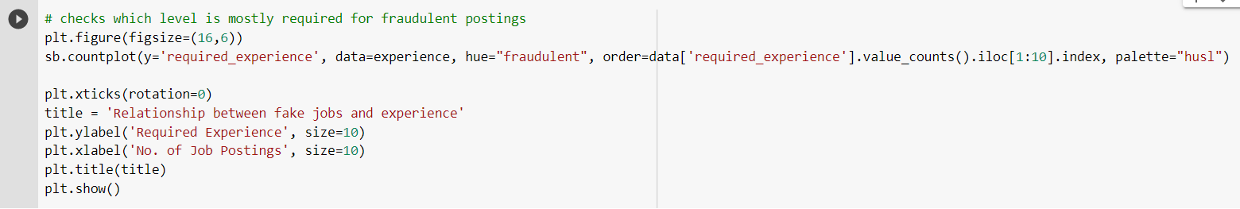
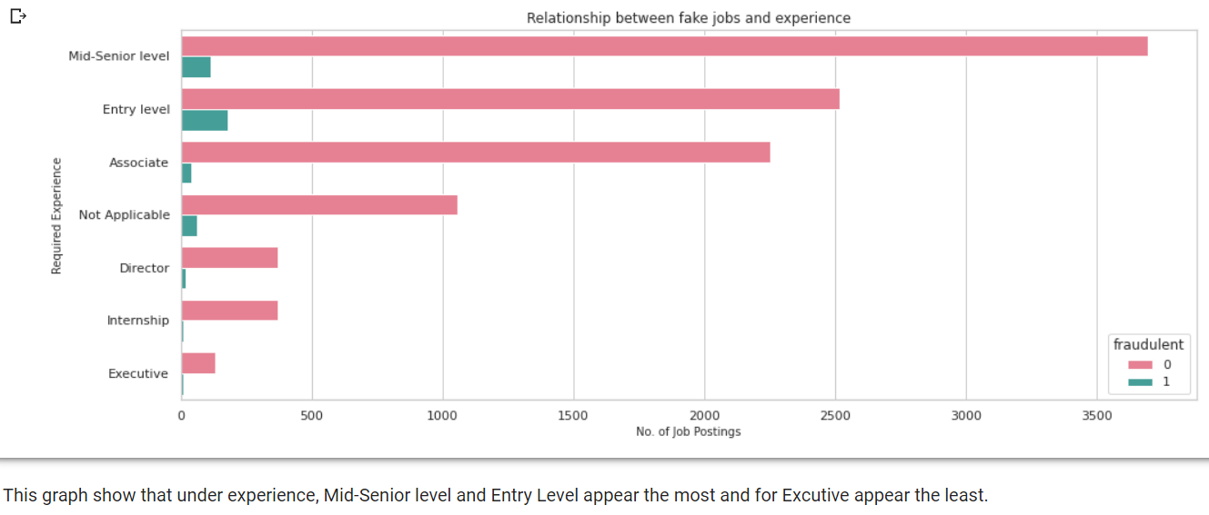
Exploratory Data Analysis - Data Visualization
How does experience relate to fake jobs?

Slide 10
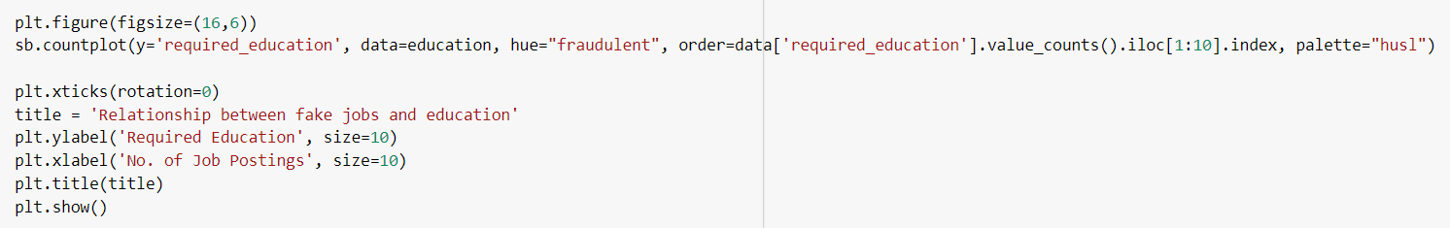
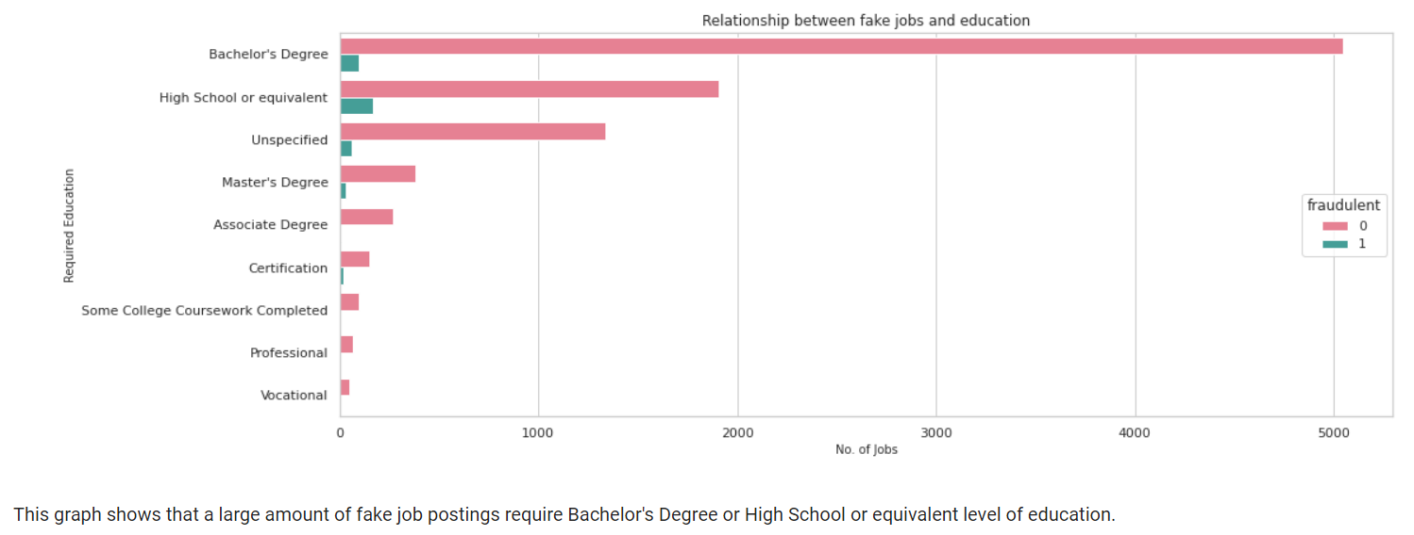
Exploratory Data Analysis - Data Visualization
How does education level relate to fake jobs?

Slide 11
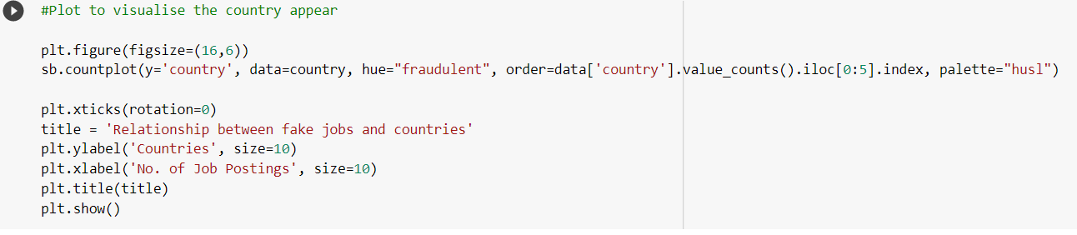
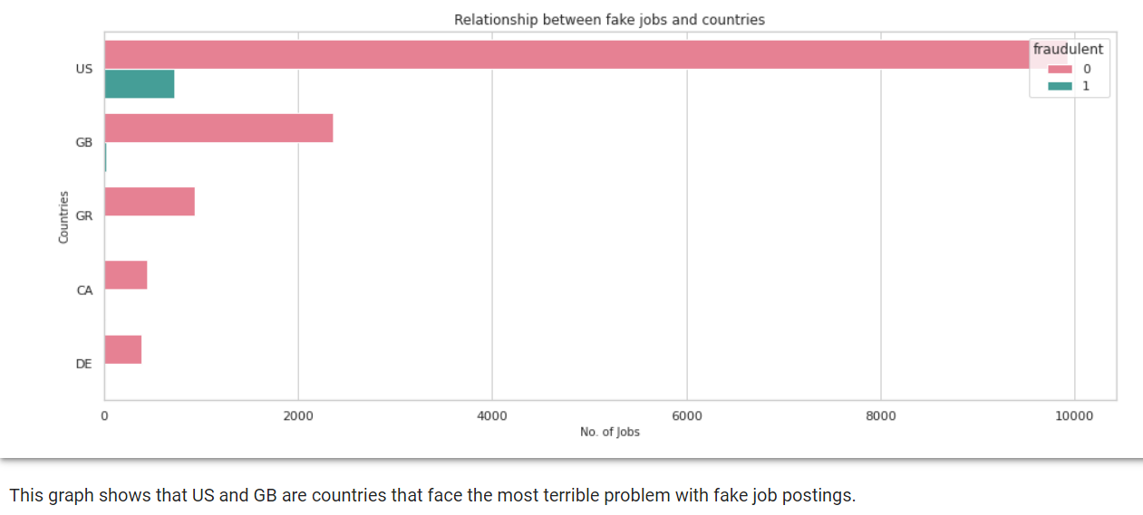
Exploratory Data Analysis - Data Visualization
Which countries have the biggest amount of fake job postings?

Slide 12
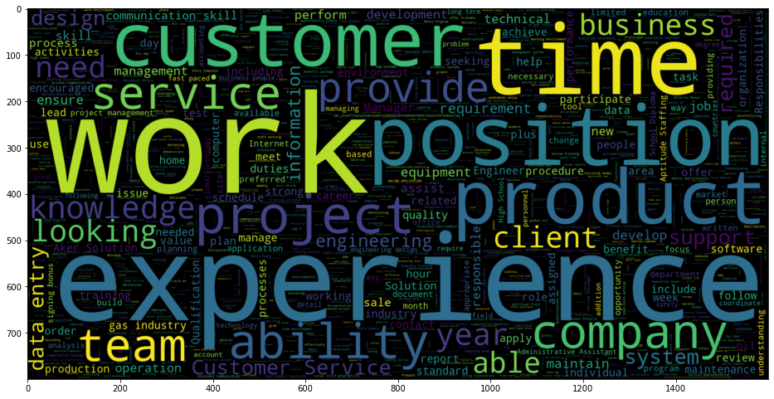
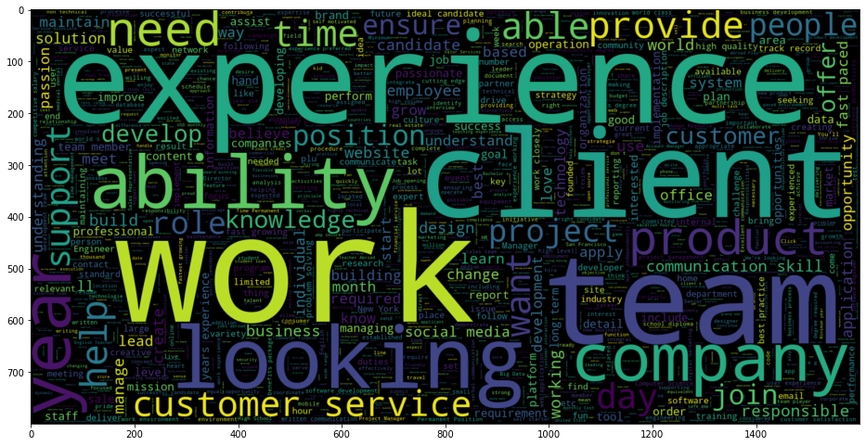
Exploratory Data Analysis - Data Visualization
Word Cloud Visualization:
Fake job Wordcloud
Real job Wordcloud

Slide 13
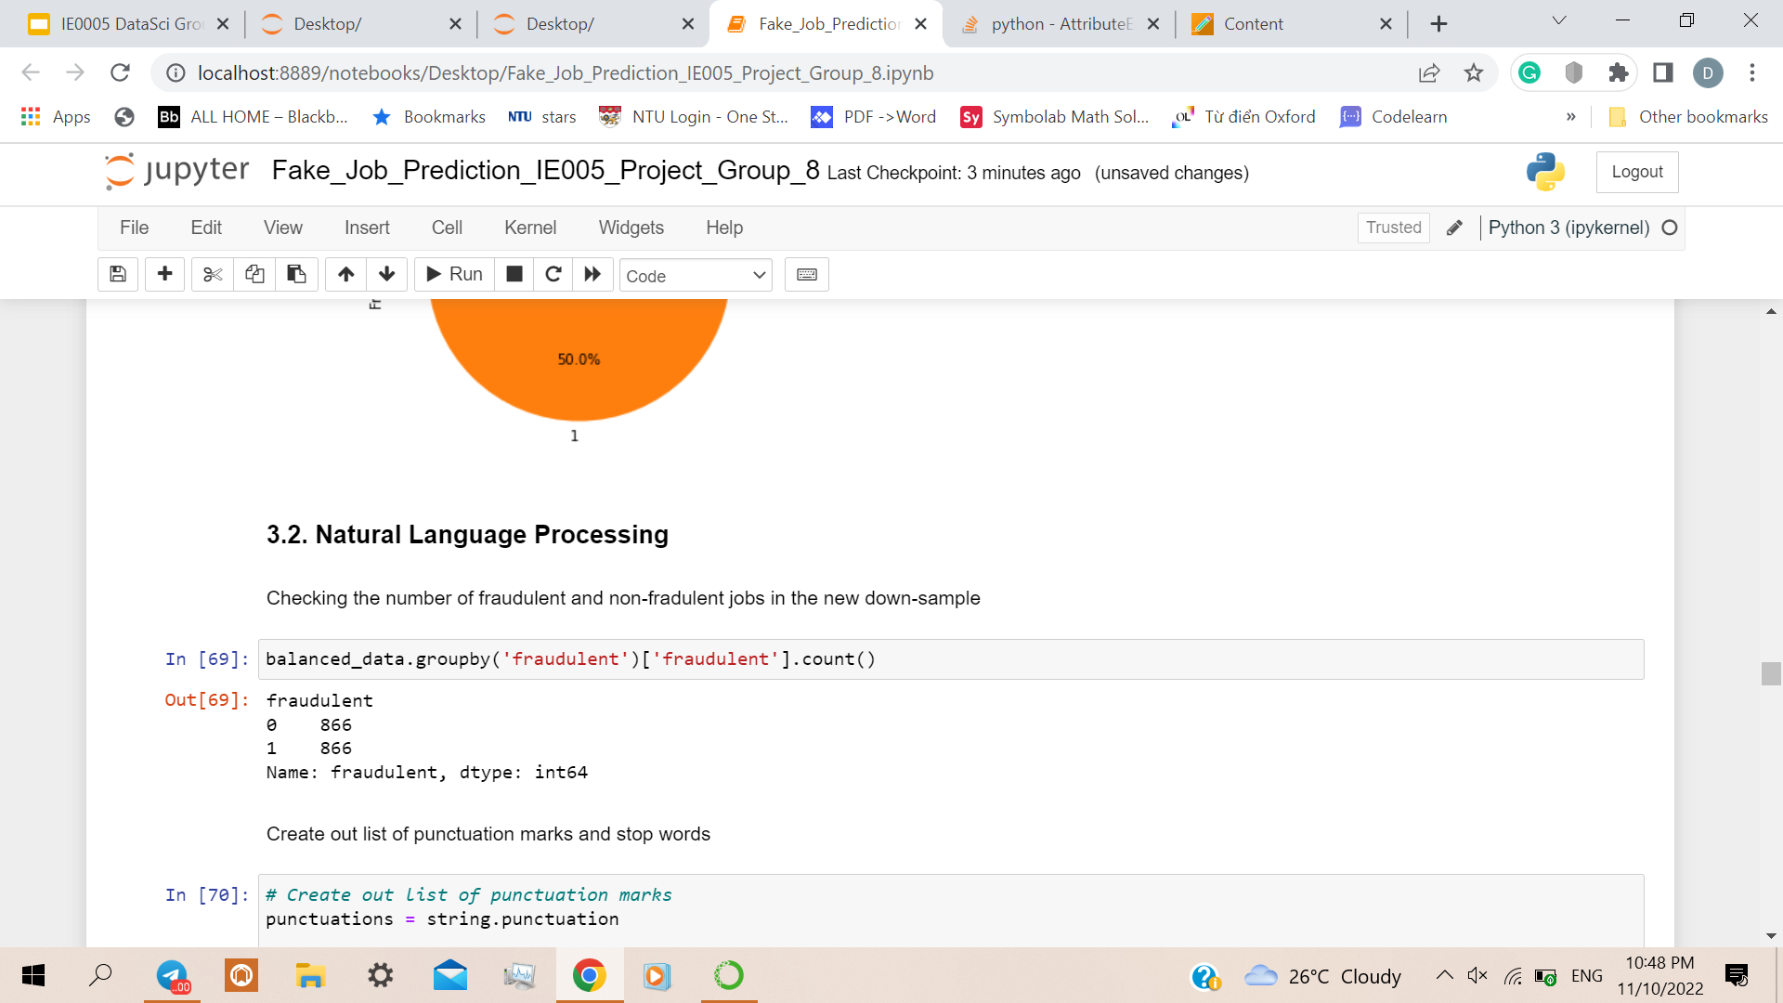
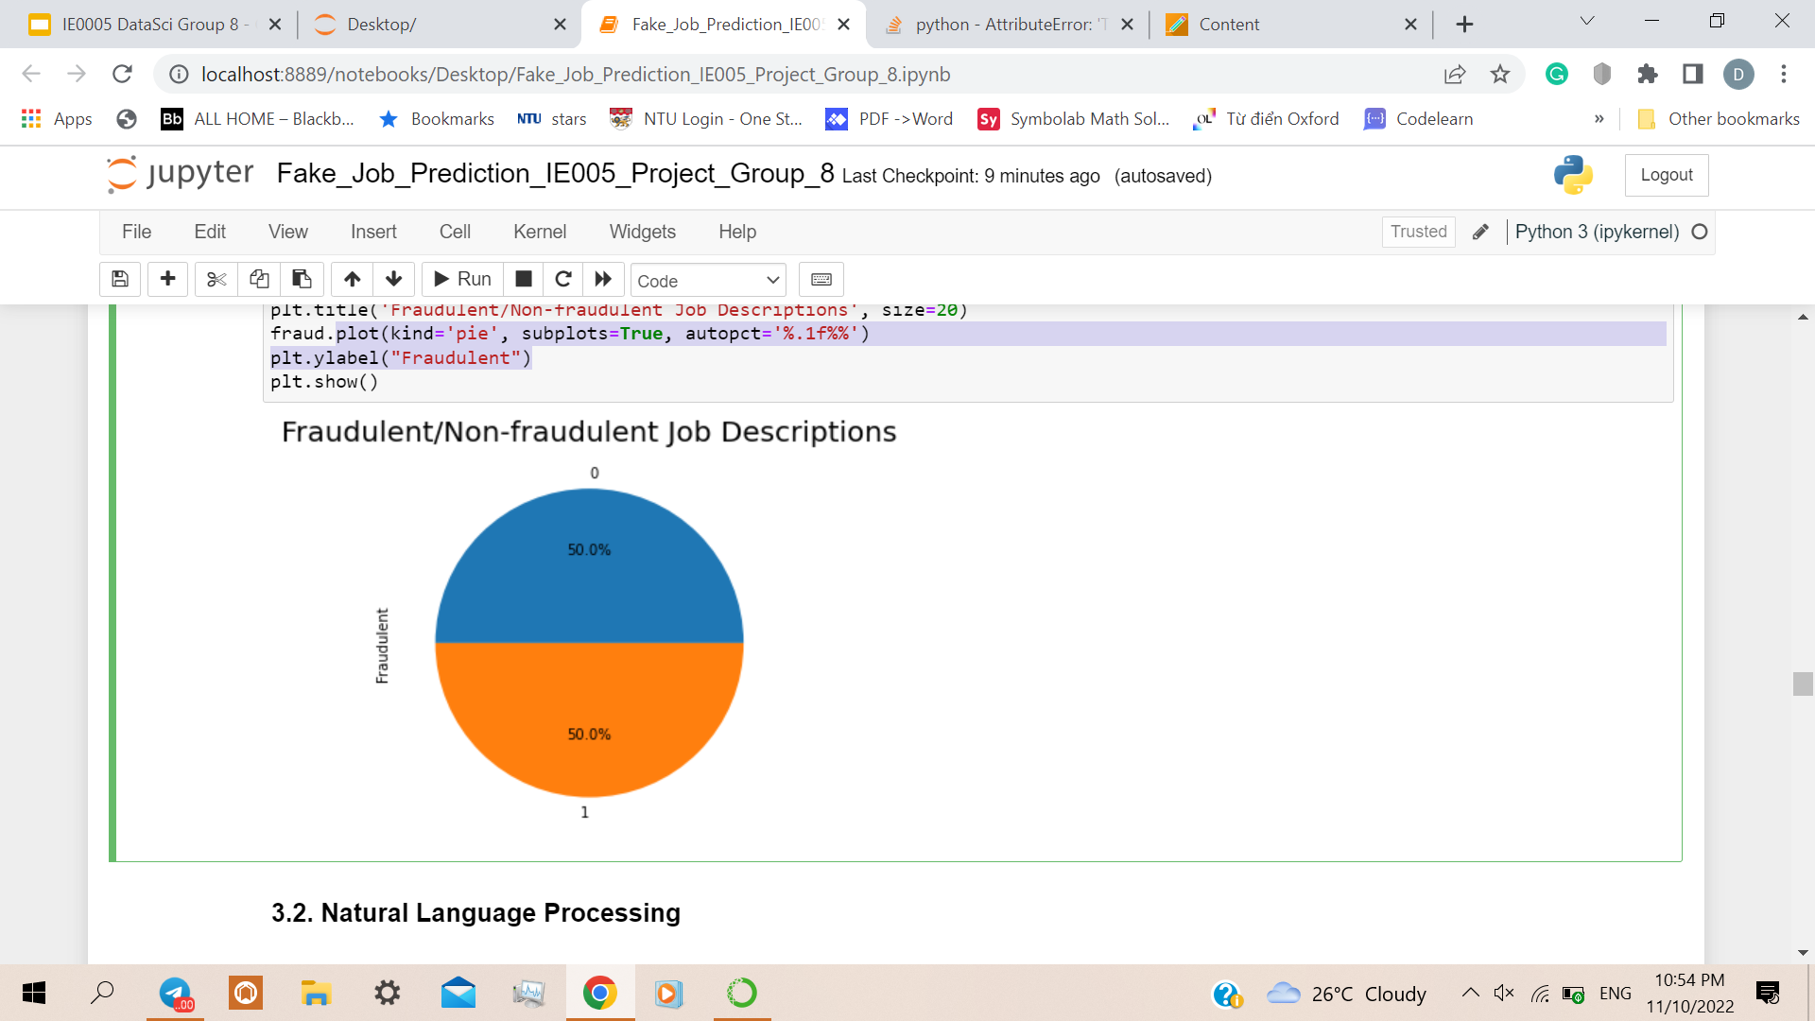
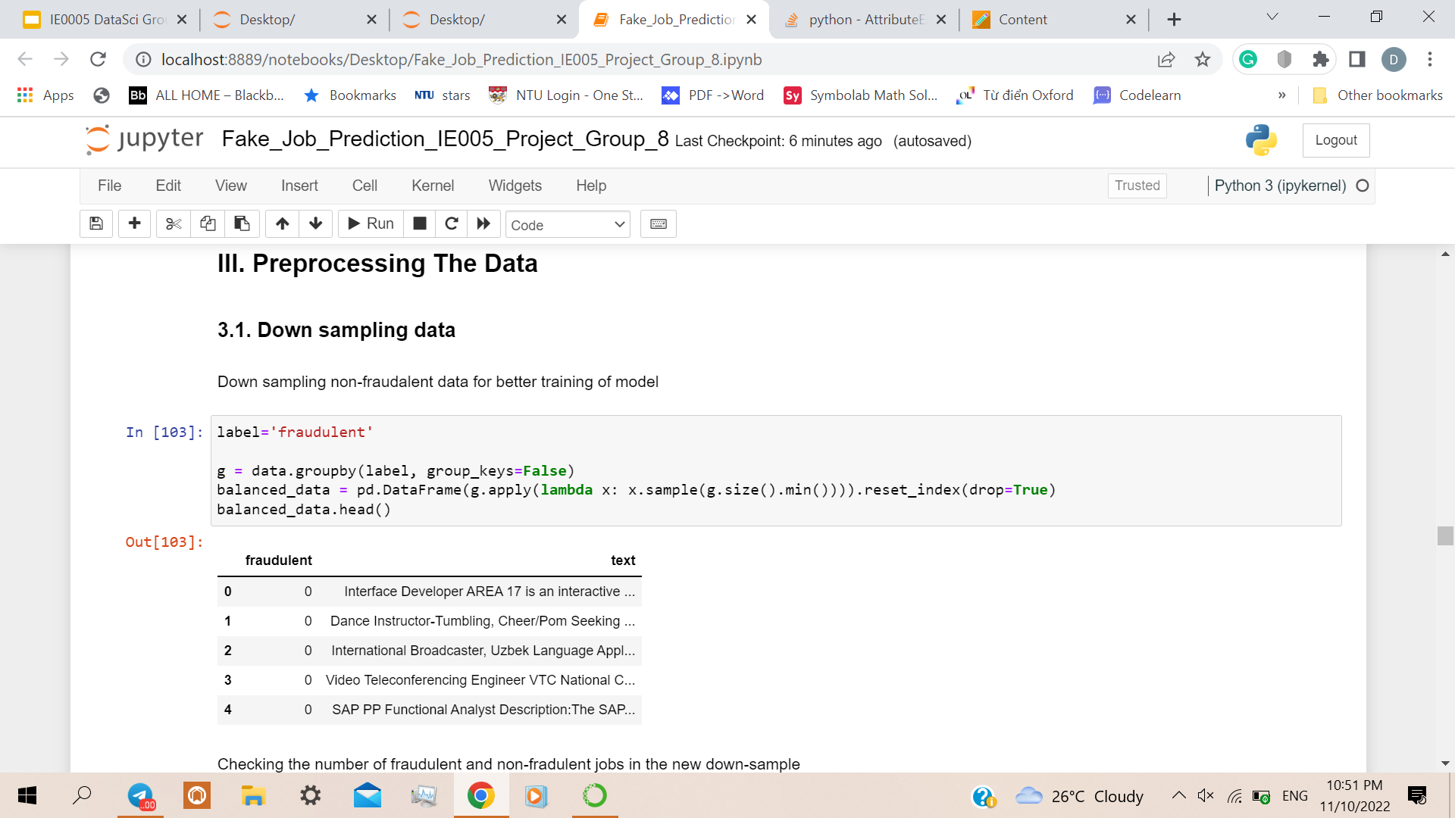
Pre-processing Data for Training the model
Since the data is highly unbalanced, we choose to down sample the data so we can avoid bias

Slide 14
Pre-processing Data for NLP
Tokenization: The textual data is split into smaller units. In this case, the data is split into words.
To Lower: The split words are converted to lowercase
Stopword removal: Stopwords are words that do not add much meaning to sentences. For example, the, a, an, he, have, etc. These words are removed.
Lemmatization: The process of lemmatization groups in which inflected forms of words are used together.

Slide 15
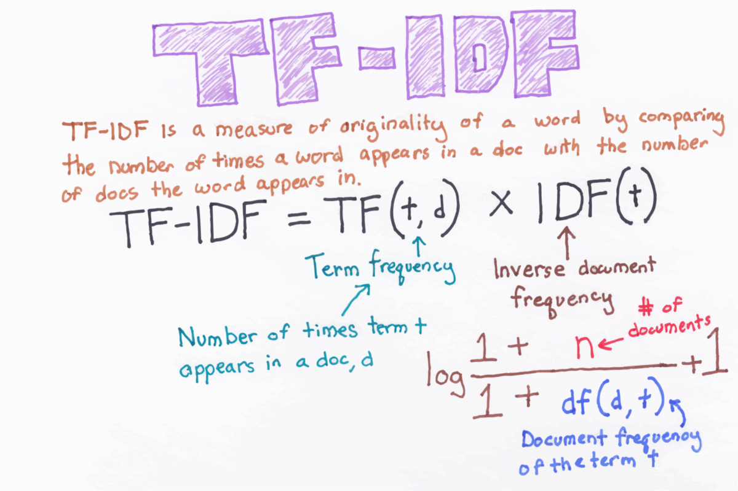
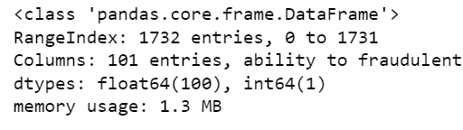
Exploratory Data Analysis - Usage of TF-IDF Vectorizer
TF- IDF = Term Frequency - Inverse Document Frequency Vectorizer.
The Logarithmic factor in TF-IDF mathematically penalizes words that are too abundant in the text by giving them low TF-IDF scores
Higher TF-IDF values = higher importance in the text
Lower TF-IDF values = lower importance in the text
Vector size
Notes:
TFIDF Vectorizer:
Term frequency and inverse document frequency
Shows the weight of each word in the dataframe.

Slide 16

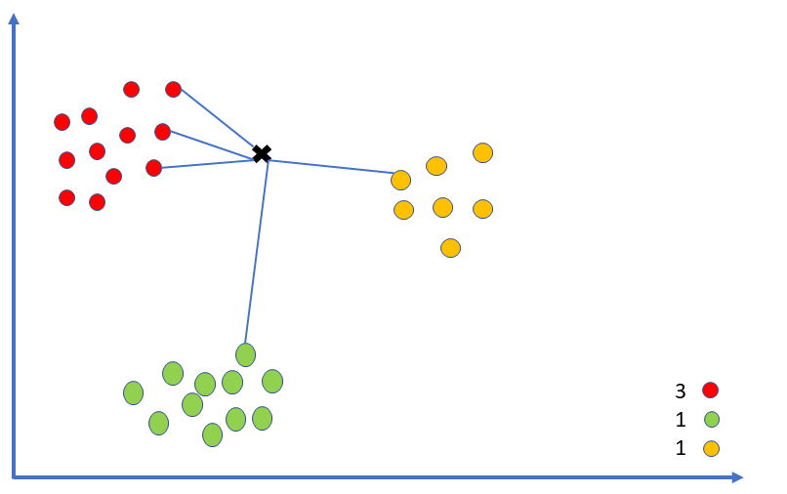
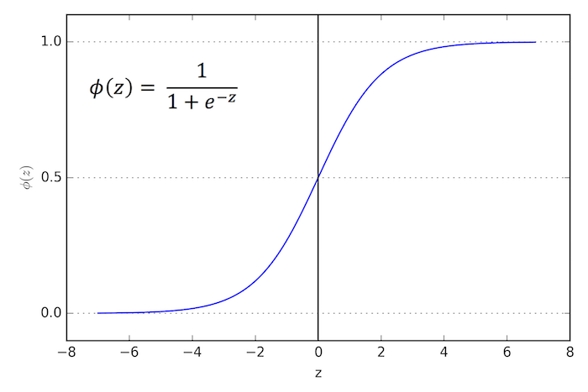
Training the model: Overview
We try 3 different classification ML models to train the data
We use classification methods because the data is highly unstructured
Random Forest
K-Nearest Neighbors
Logistic Regression

Slide 17
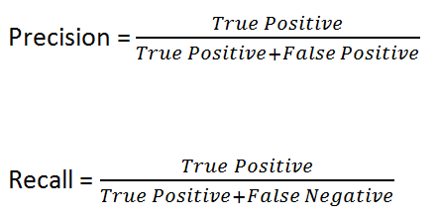
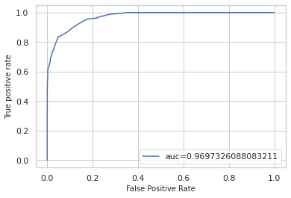
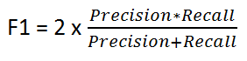
Train the model: Approach
We divide the data into train set and test set with the ratio 70:30
We train each model and apply them to the test set to find out:
Accuracy, Precision,Recall F1-score
Confusion matrix
ROC graph
Notes:
https://towardsdatascience.com/accuracy-precision-recall-or-f1-331fb37c5cb9

Slide 18
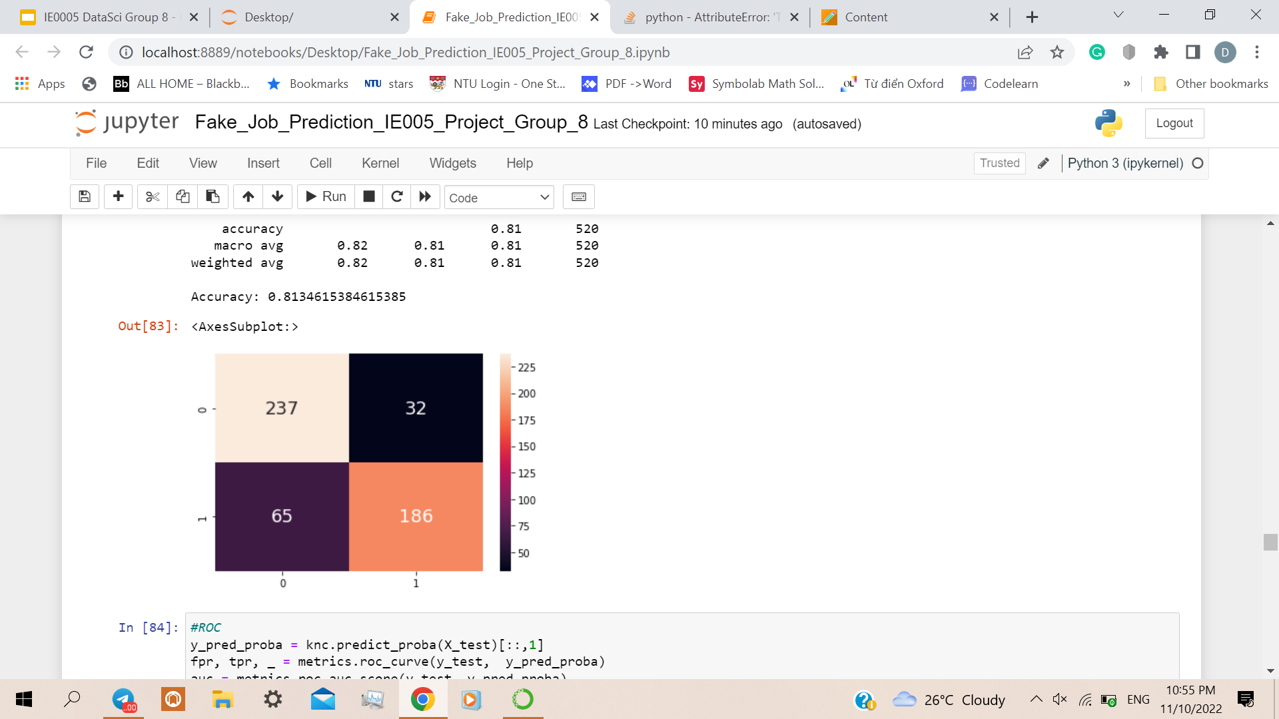
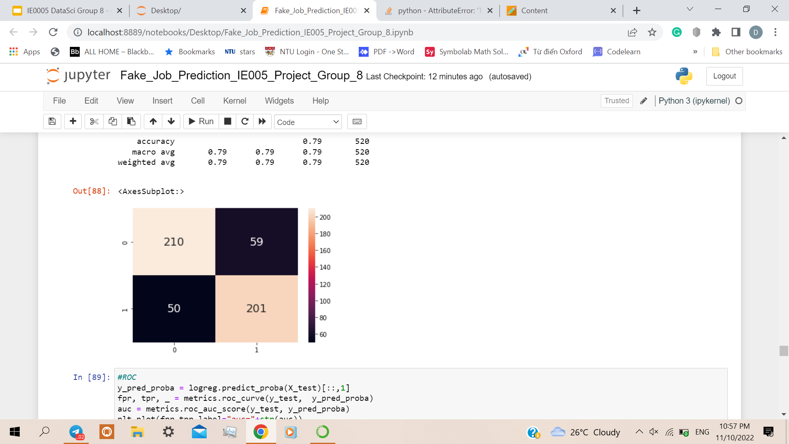
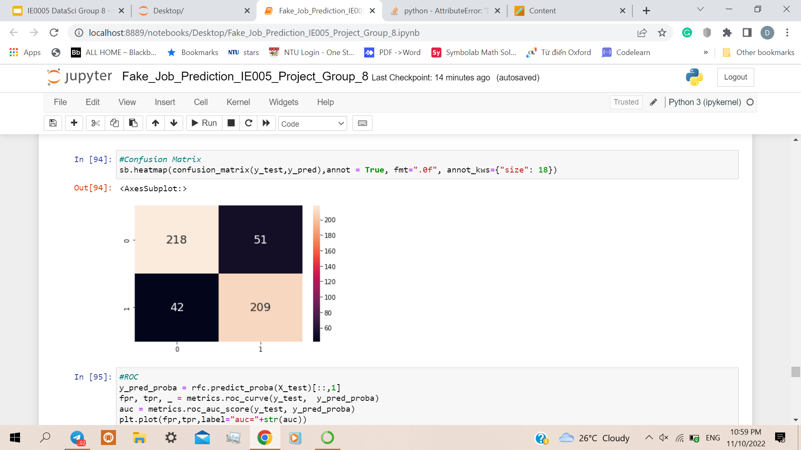
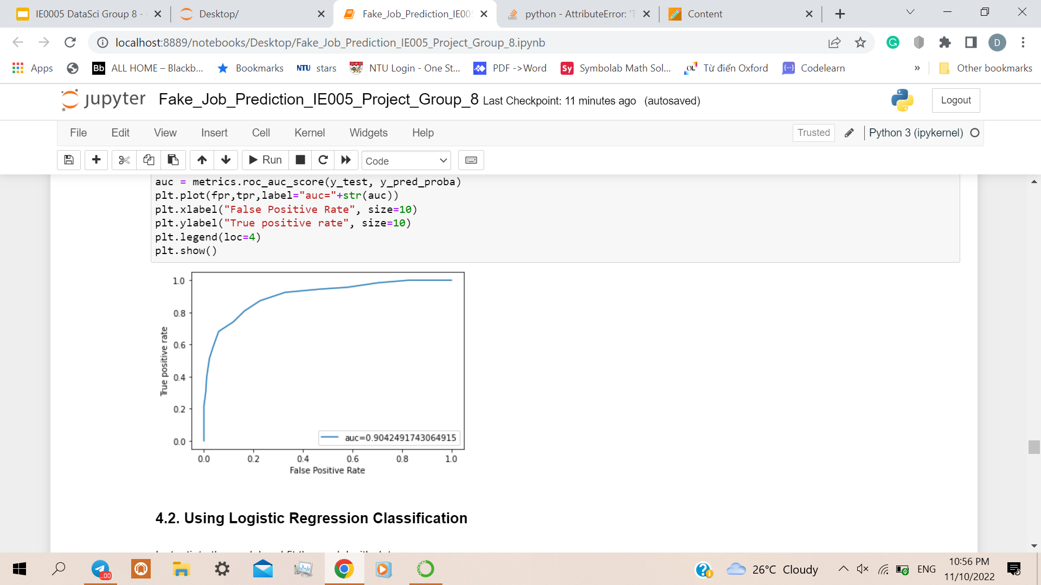
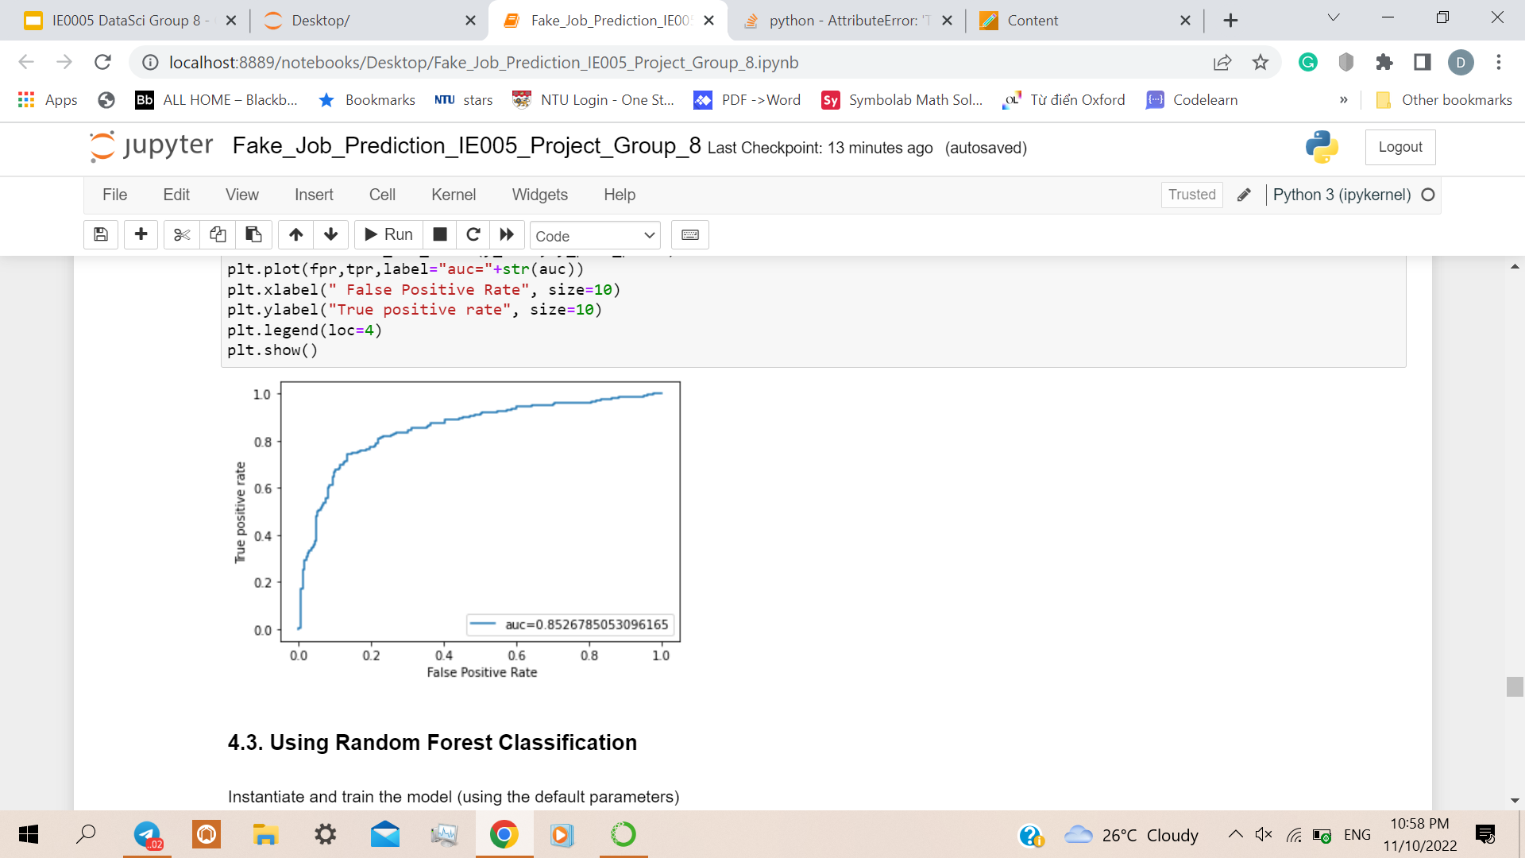
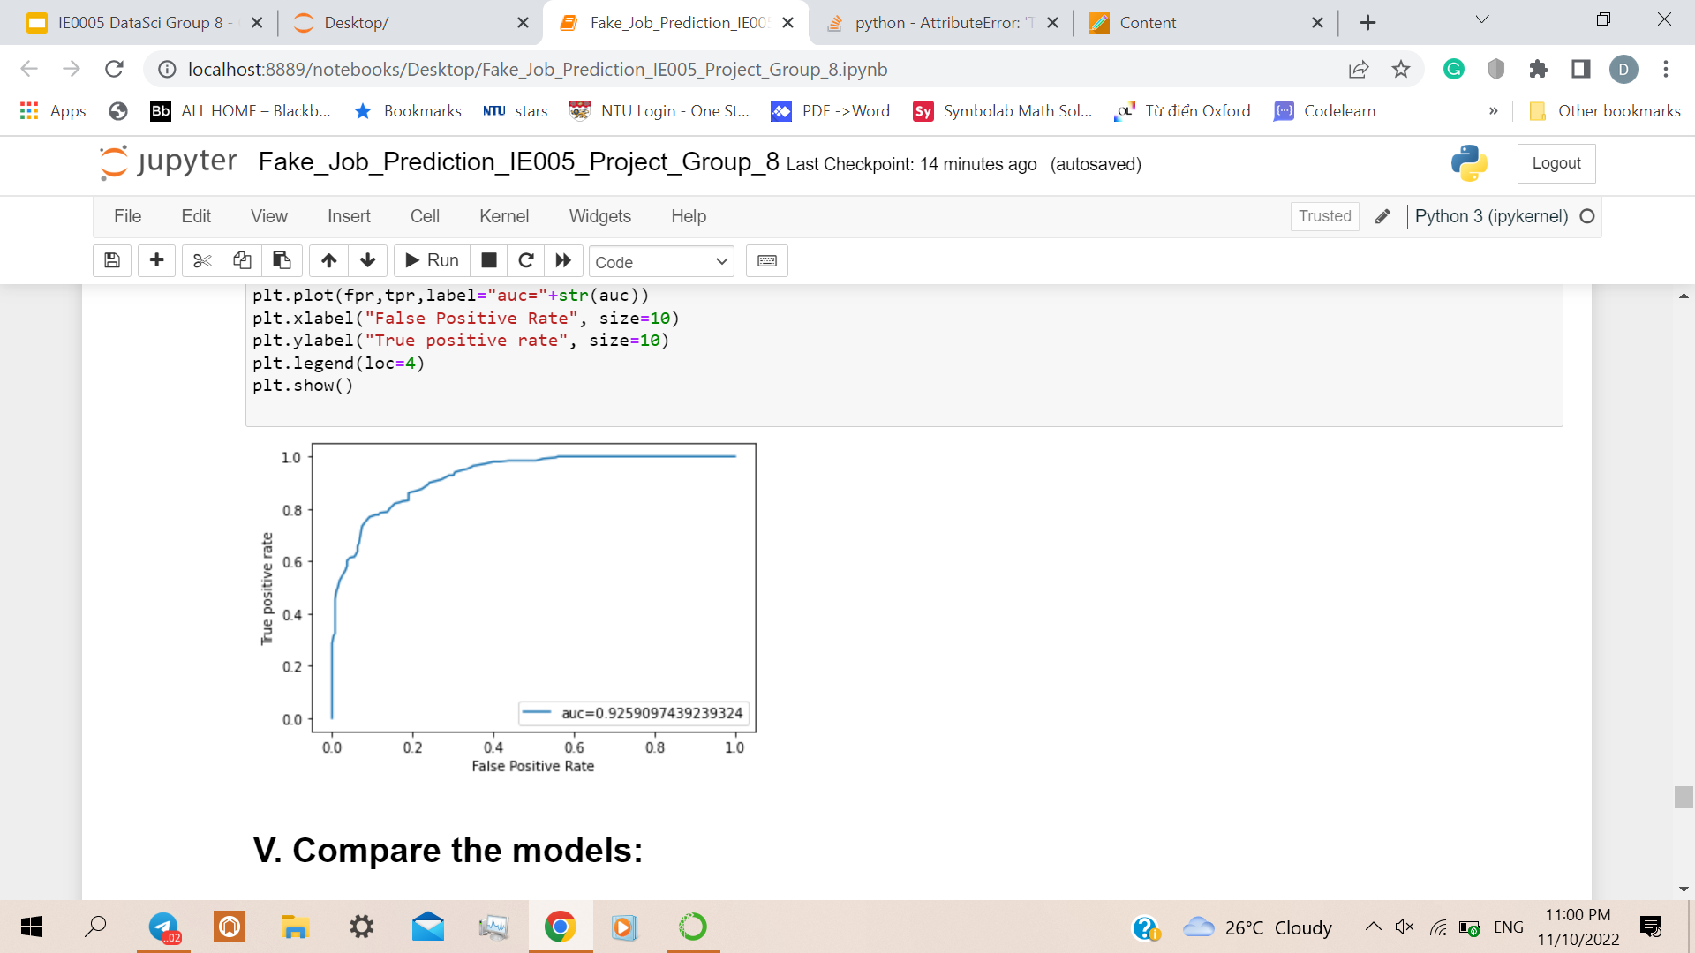
Model Analysis
KNN
Logistic
Random Forest

Slide 19
Comparison of the model
 | Accuracy | Precision | Recall |  | F1-Score
KNN | 0.813462 | 0.853211 | 0.741036 |  | 0.793177
Logistic | 0.790385 | 0.773077 | 0.800797 |  | 0.786693
Random Forest | 0.821154 | 0.803846 | 0.832669 |  | 0.818004

Slide 20
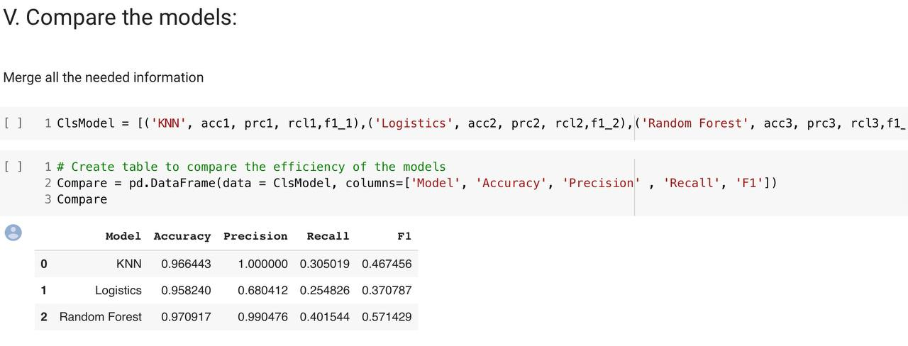
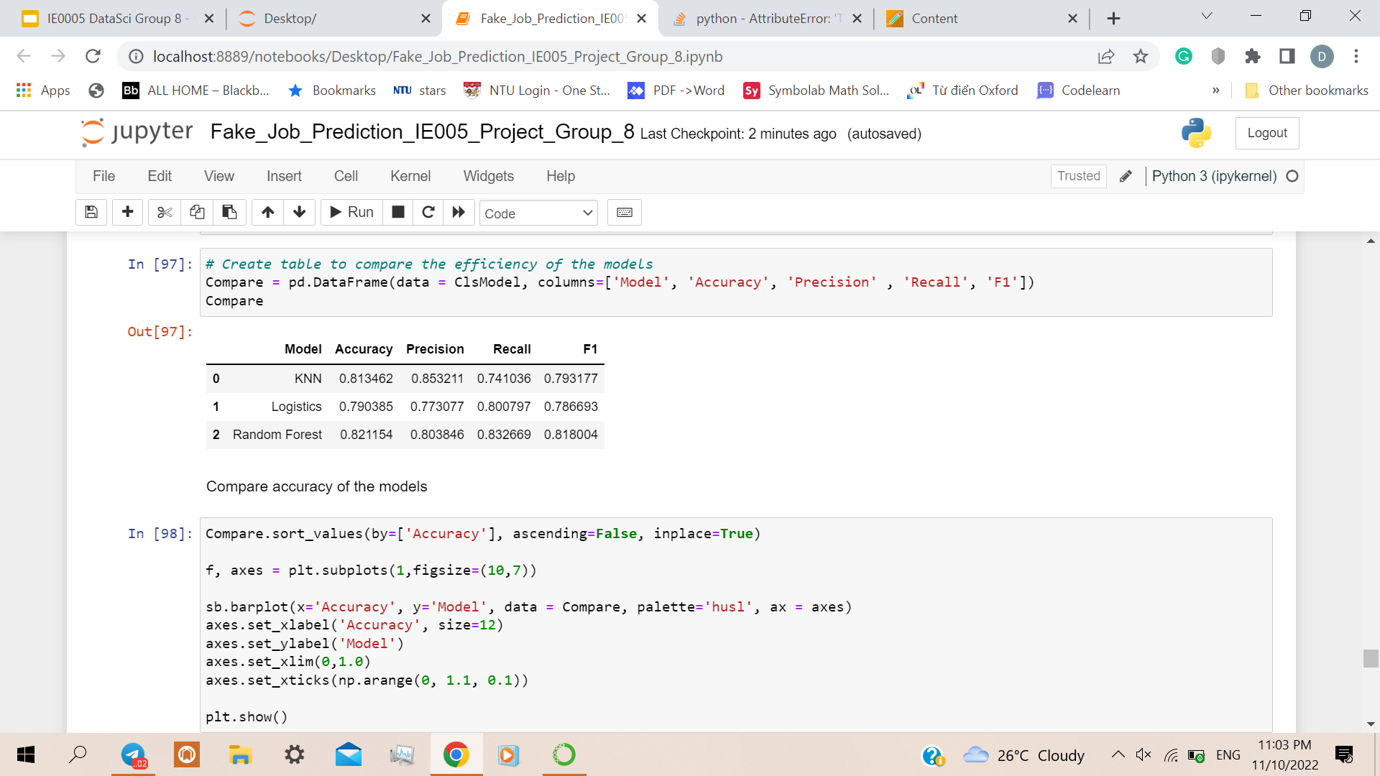
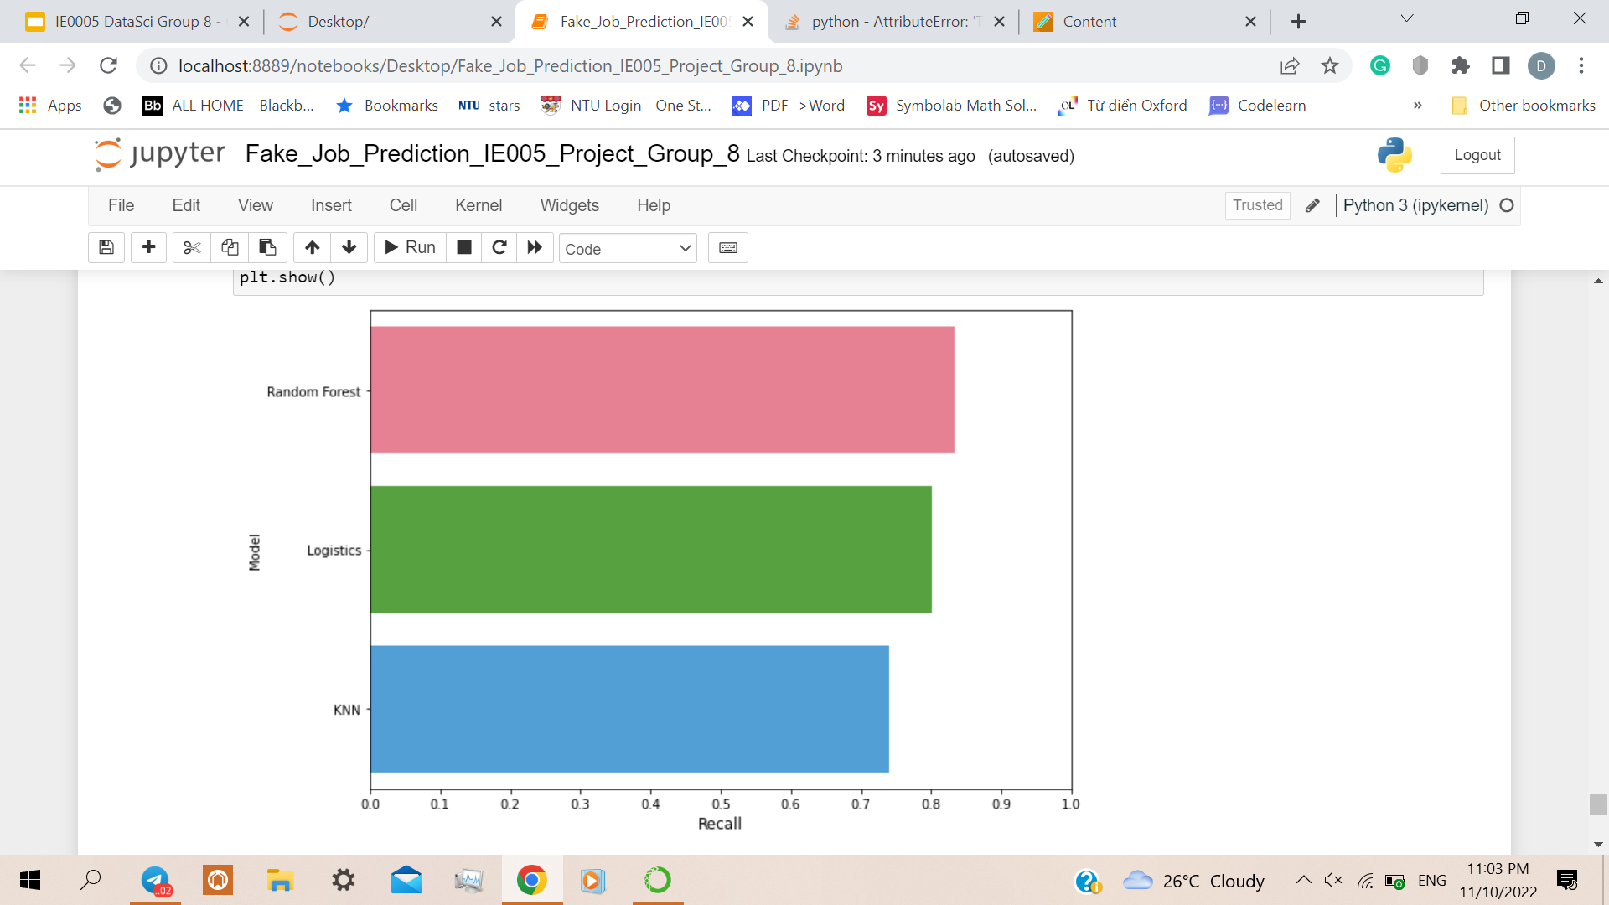
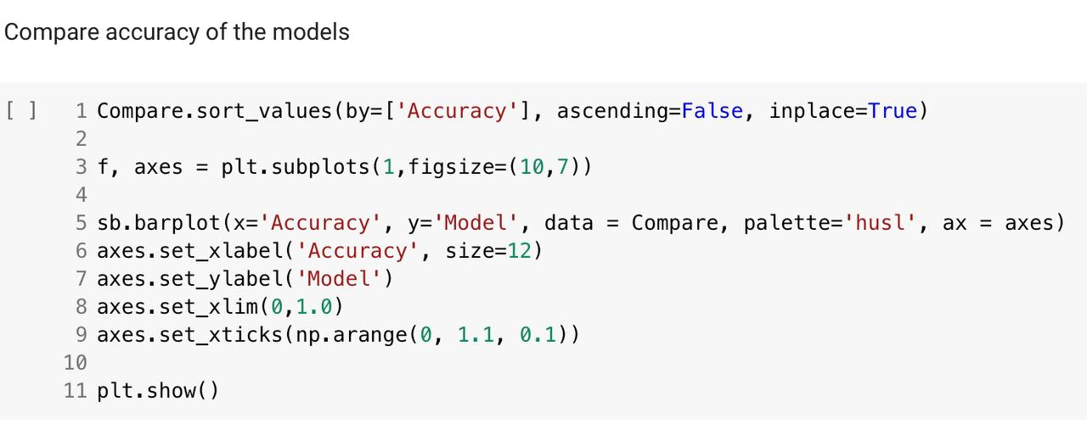
Conclusion
We manage to obtain how accurate is our code.
We check in our test dataset to see what is the accuracy.

Slide 21
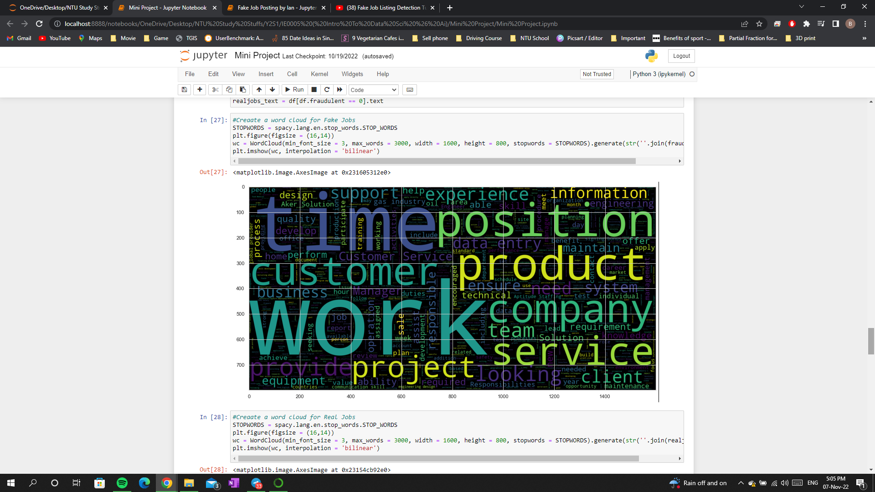
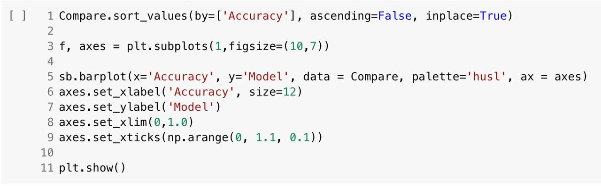
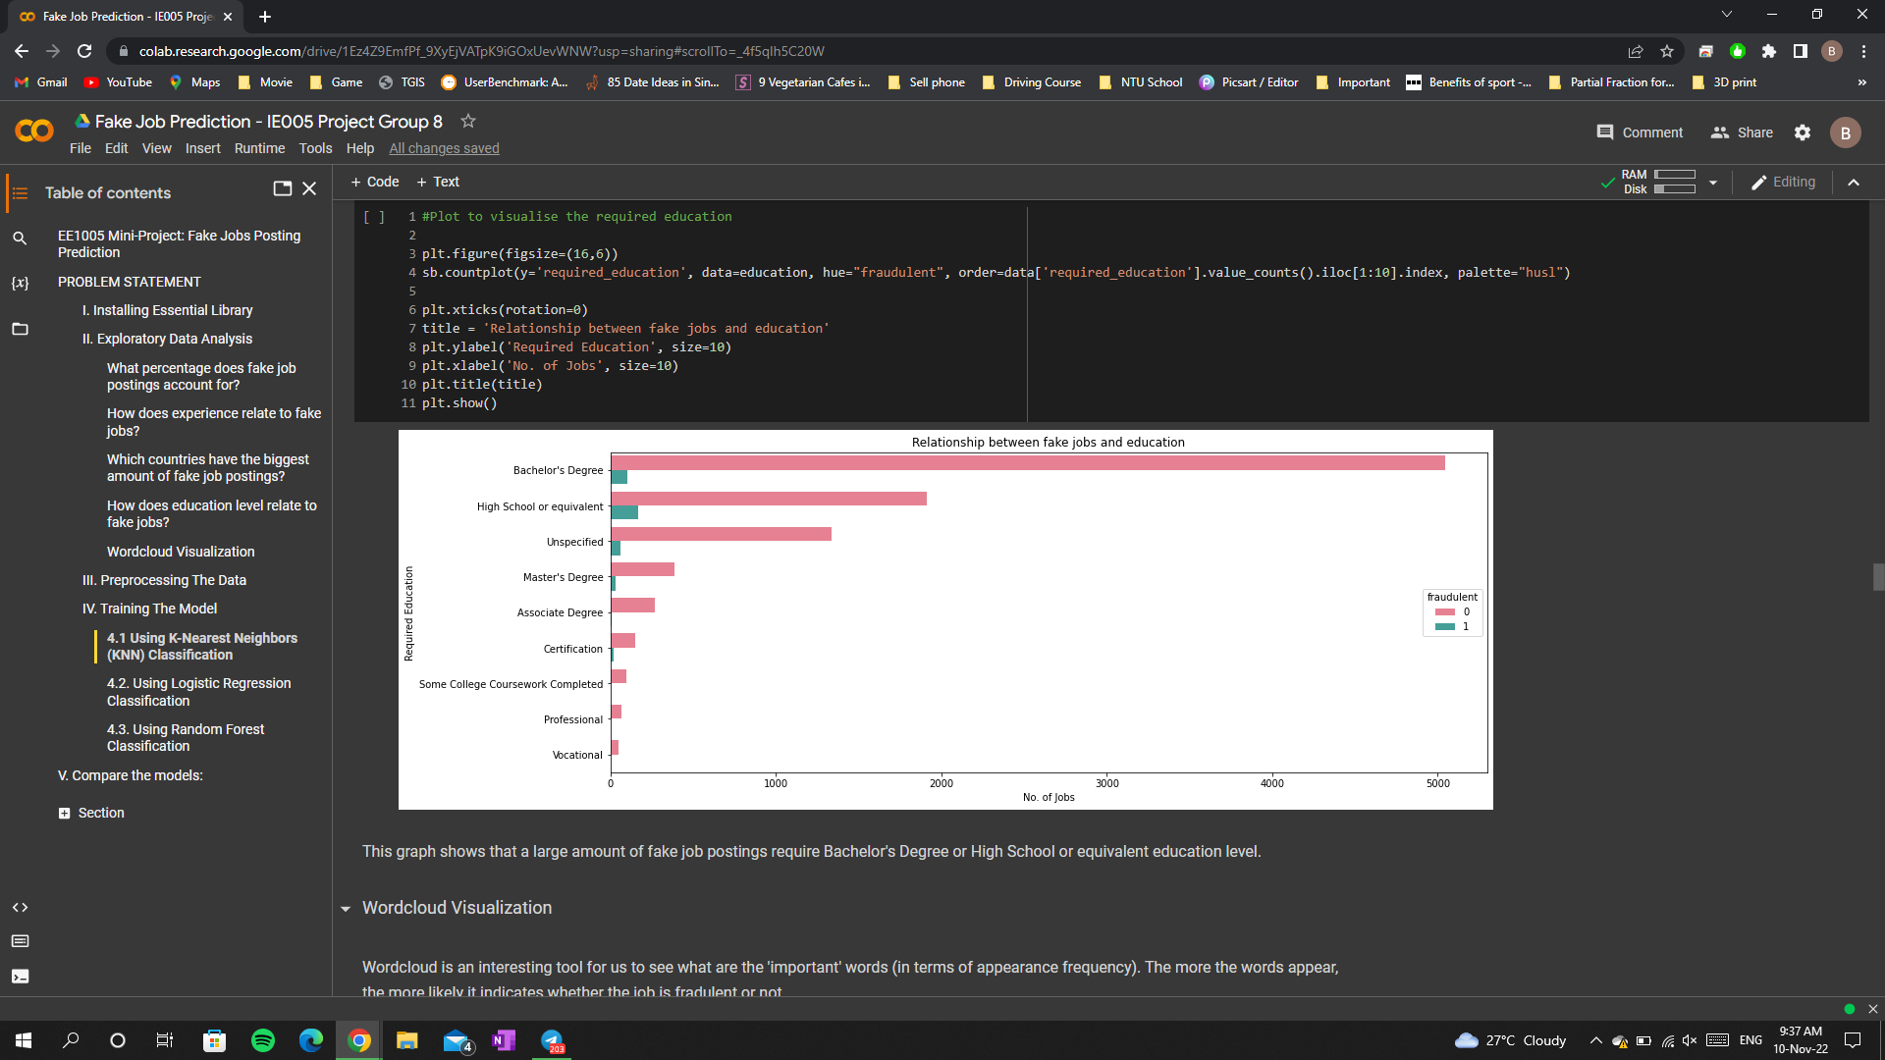
Contribution of work
Tuan
Bernard
All Data Visualization
Count Plot
Stem Plot
Word Cloud
Delete Columns
Split the dataset
Comparing Final Data

Slide 22
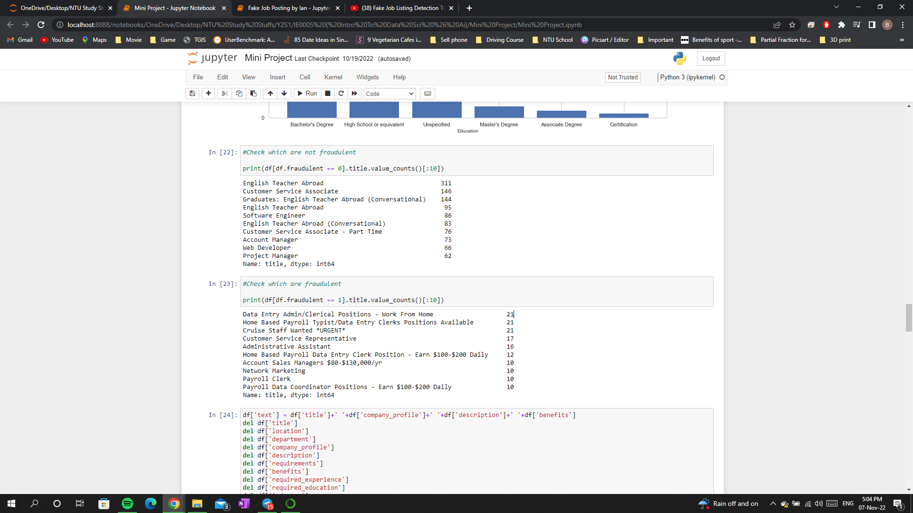
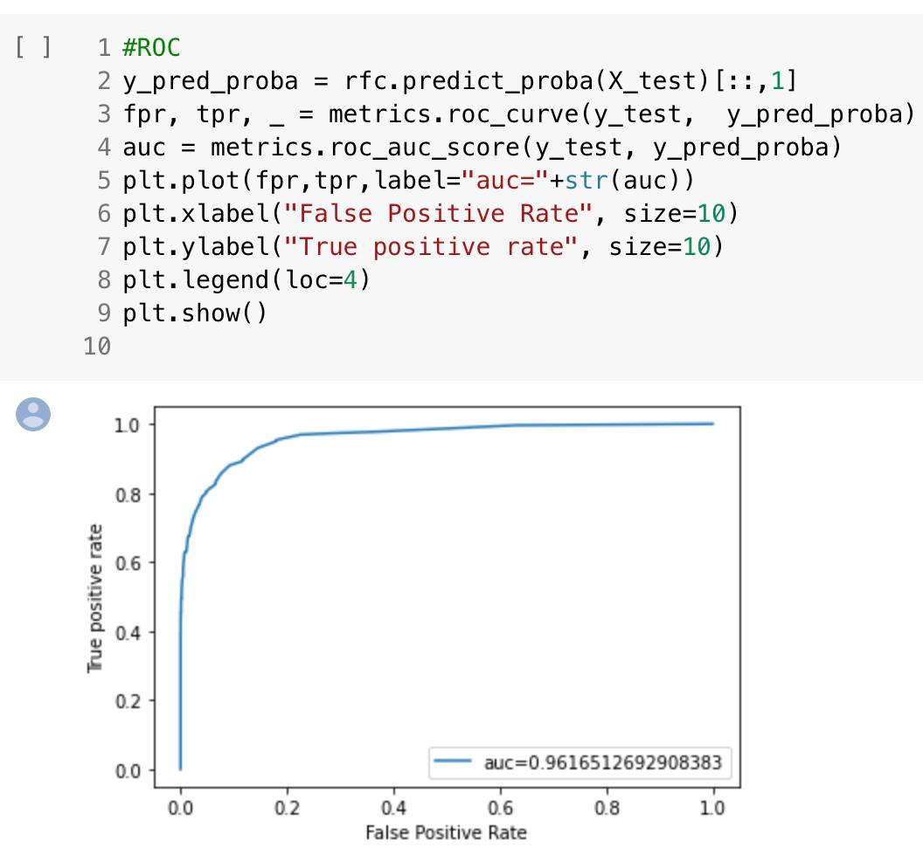
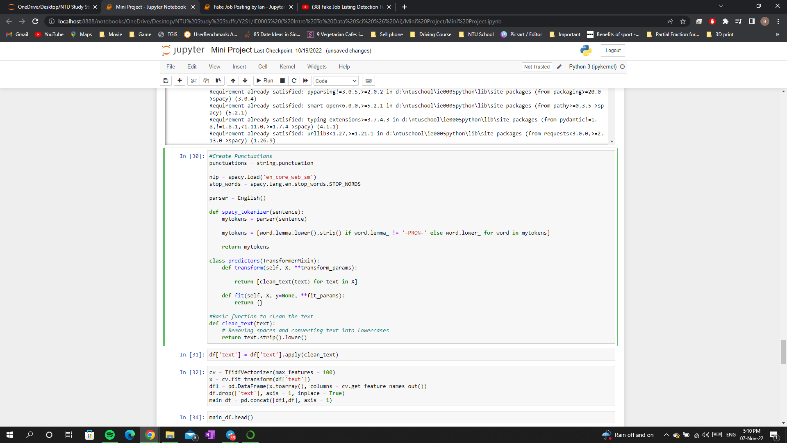
Contribution of work
Ian
Duc
Check if its Fraud or not
Pre-processing Data (NLP)
Random Forest
Logistic Regression
K-Nearest Neighbors
Model Analysis

Slide 23
THANKS
Do you have any questions?

Slide 24
Reference Link
https://quantdare.com/decision-trees-gini-vs-entropy/
https://developers.google.com/machine-learning/crash-course/classification/roc-and-auc
https://towardsdatascience.com/accuracy-precision-recall-or-f1-331fb37c5cb9
https://scikit-learn.org/

